Slide 1
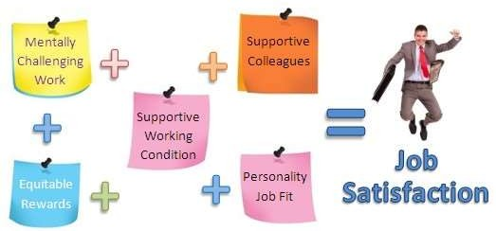
JOB SATISFACTION
Cdr Vijay Pratap Singh, Adjunct Professor, TCET

Slide 2
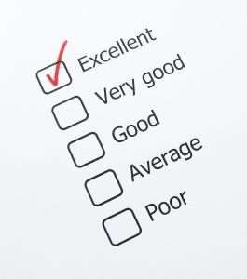
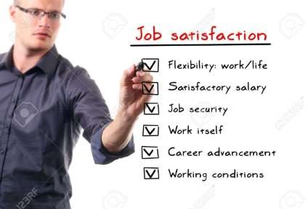
MEASUREING JOB SATISFACTION
SINGLE GLOBAL RATING.
SUMMATION OF JOB FACETS.

Slide 3
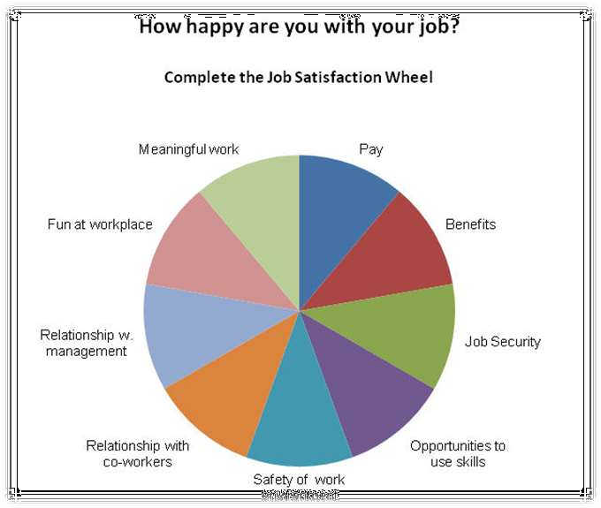
HOW SATISFIED ARE PEOPLE IN JOB

Slide 4



WHAT CAUSES JOB SATISFACTON
CULTURE
INTERESTING WORK
REWARDS
LOW STRESS

Slide 5

IMPACT OF SATISFIED AND DISSATISFIED EMPLOYEES ON WORK PLACE
EXIT
VOICE
LOYALITY
NEGLECT

Slide 6
SPECIFIC OUTCOME OF JOB SATISFACTION & DISSATISFACTION
JOB SATISFACTION & ORGANIZATIONAL CITIZENSHIP BEHAVIOUR
JOB SATISFACTION & PEFORMANCE
JOB SATISFATION & COUSTMER SATISFACTION
JOB SATISFACTION AND ABSENTEESIM
JOB SATISFACTION AND TURNOVER
JOB SATISFACTION AND WORKPLACE

Slide 7

Thank You

